Slide 1
STUDENT ACADEMIC UPDATE & PERFORMANCE PREDICTION

Slide 2
STUDENT ACADEMIC UPDATE & PERFORMANCE PREDICTION
Submitted by,
A.Yuvaraj
II M.C.A ,
20214012404160,
Department of CSE,
Manonmaniam Sundaranar University,
Tirunelveli.
under the guidance of,
Dr.R.S.Rajesh.,M.E.,Ph.D.,
Professor,
Department of CSE,
Manonmaniam Sundaranar University,
Tirunelveli.

Slide 3
Content
S. No | Title | Slide No
1 | Objective | 4
2 | System Analysis | 5
3 | Novelty | 7
4 | System Requirement | 8
5 | System Design | 9
6 | Sample Output

Slide 4
1.Objective:
The Main objective is to developed a platform for student and faculty member to effectively manage the activities of attendance maintenance , Assignments , seminar etc.
Reduce the paper work and saving time to generate accurate results from student’s performance.
It is also proposed to apply a basic Machine Learning concepts to predict overall performance of the student.

Slide 5
2.System Analysis :
2.1 Existing System :
In existing system there are various problem like .
Collect all the document manually.
Time consuming for this process is very high.
Maintaining all hard copies of record is difficult.

Slide 6
2.2 Proposed System :
Database
User name, Password
Admin
Faculty
Student
Faculty Subject Allotment
Manage Faculty details
3. Manage Student details
View all Status report
Send Announcement
Internal assessment entry
Performance Remarks & Status
Send Announcement
View their seminar / assignment marks
View their internal marks
View performance status
Get notifications

Slide 7
3.Novelty of the Project :
Graphical representation
Emoji prompt service
Predict the overall performance of student

Slide 8
4.System Requirement :
4.1 Hardware Requirement :
Processer : Intel i7
RAM : 8 GB
4.2 Software Requirement :
OS : Windows 10
Front End : Html, css, Javascript
Back End : php, MySQL

Slide 9
5. System Design :
Mobile App
Website
Architecture Diagram :
Database
(Admin , Faculty)
(Student)

Slide 10
Architecture Diagram :
Website Creation:
Admin
Role
Login Page
Faculty

Slide 11
Data Flow Diagram:
Faculty Subject
Allotment
Faculty details
(add/update/ delete)
Admin
Student details
(add/update/delete)
Status report
Send Announcement

Slide 12
Internal
assessment entry
Faculty
Performance Remark & status
Send Announcement

Slide 13
Mobile App Development:
View their seminar marks
View their assignment marks
Student
Login Page
View performance status
Get notifications from Admin / Faculty

Slide 14
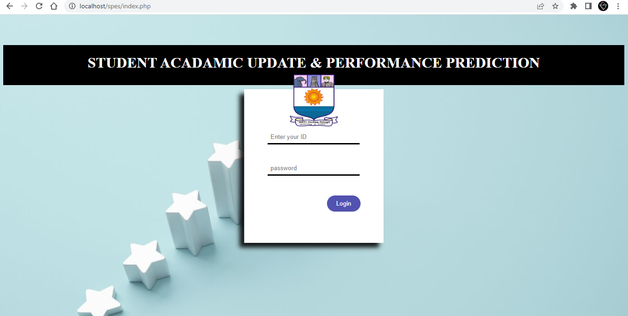

6.Sample Output :
Login page:

Slide 15
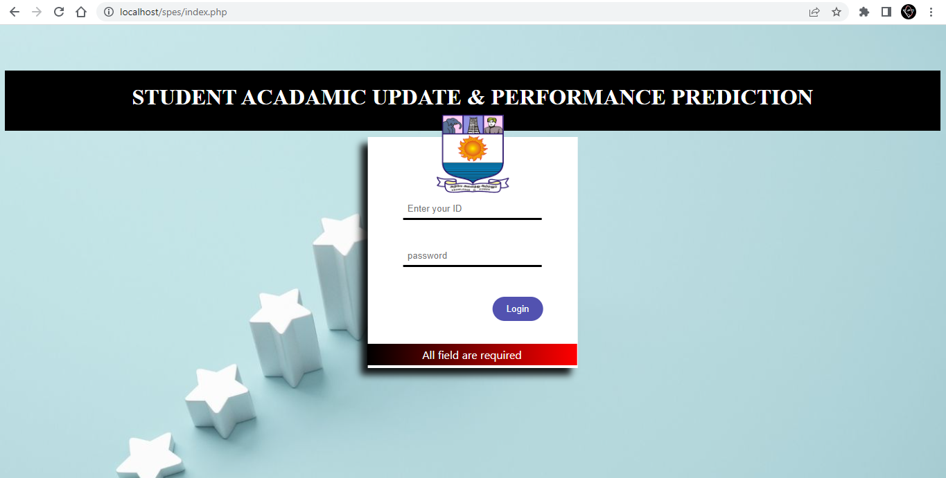
If the field is empty, it show some alert message

Slide 16
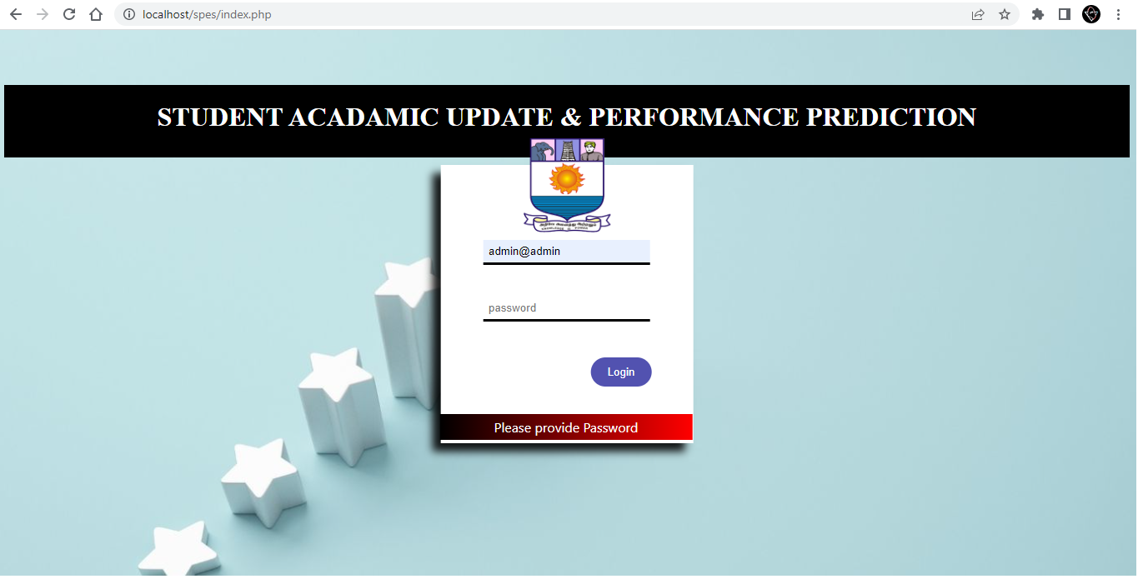
If the field is empty, it show alert message

Slide 17
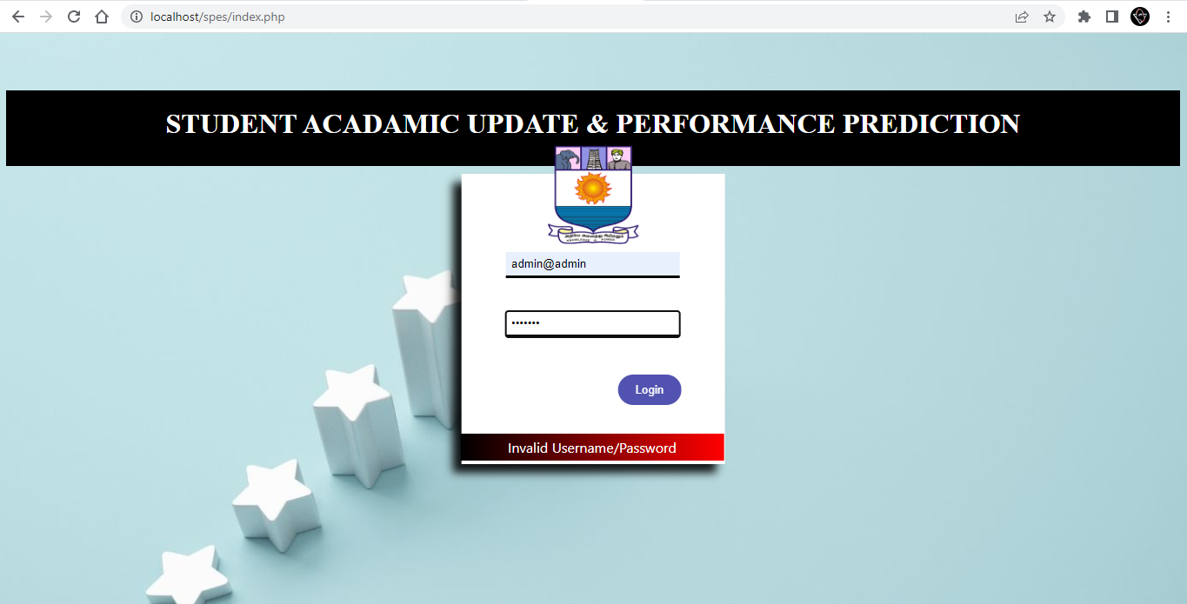
If the username / password is invalid, it show alert message

Slide 18
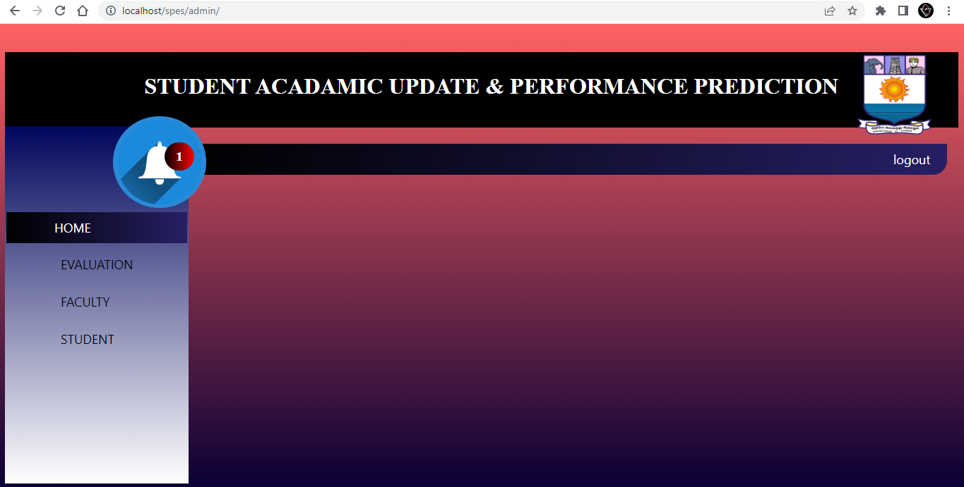
Admin Panel:

Slide 19
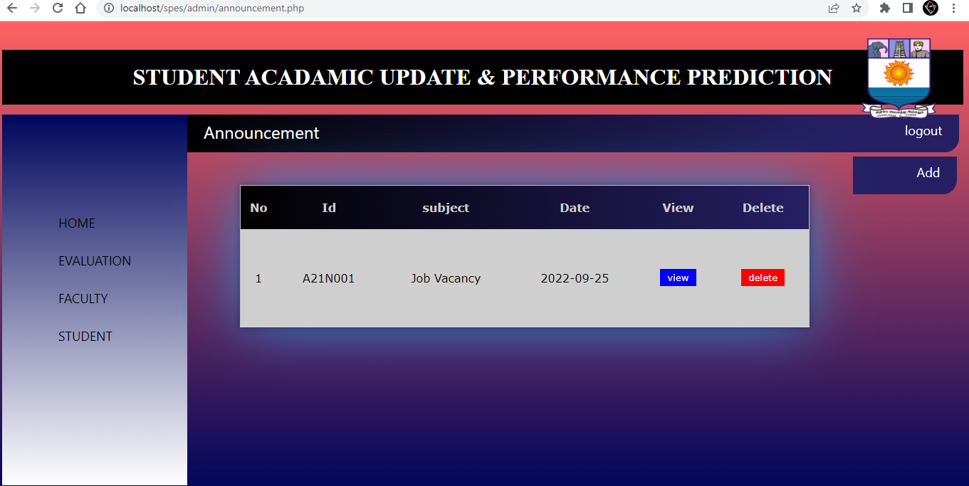
Announcement:

Slide 20
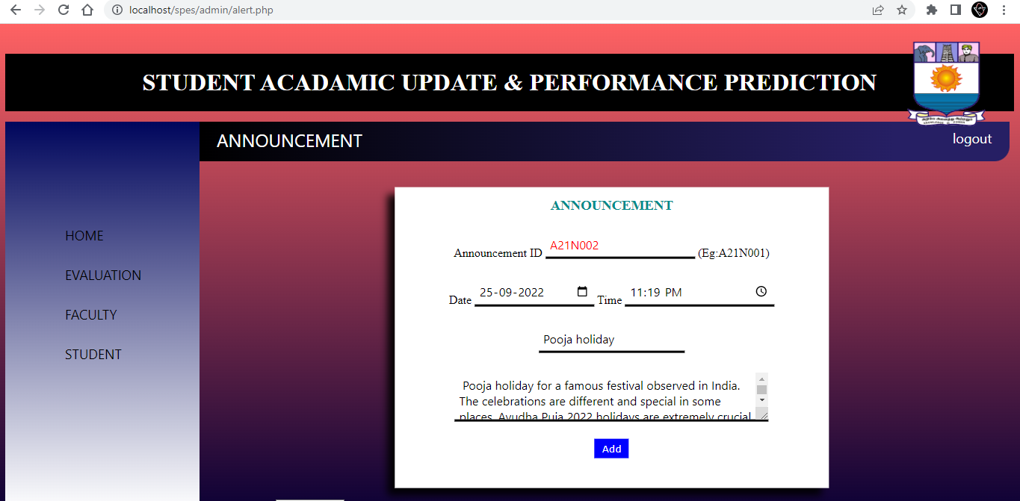
Add Announcement:

Slide 21
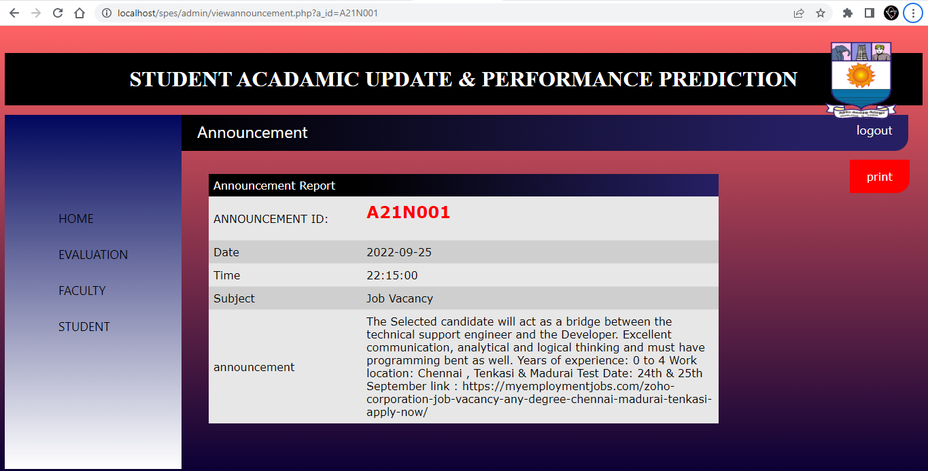
View Announcement:

Slide 22
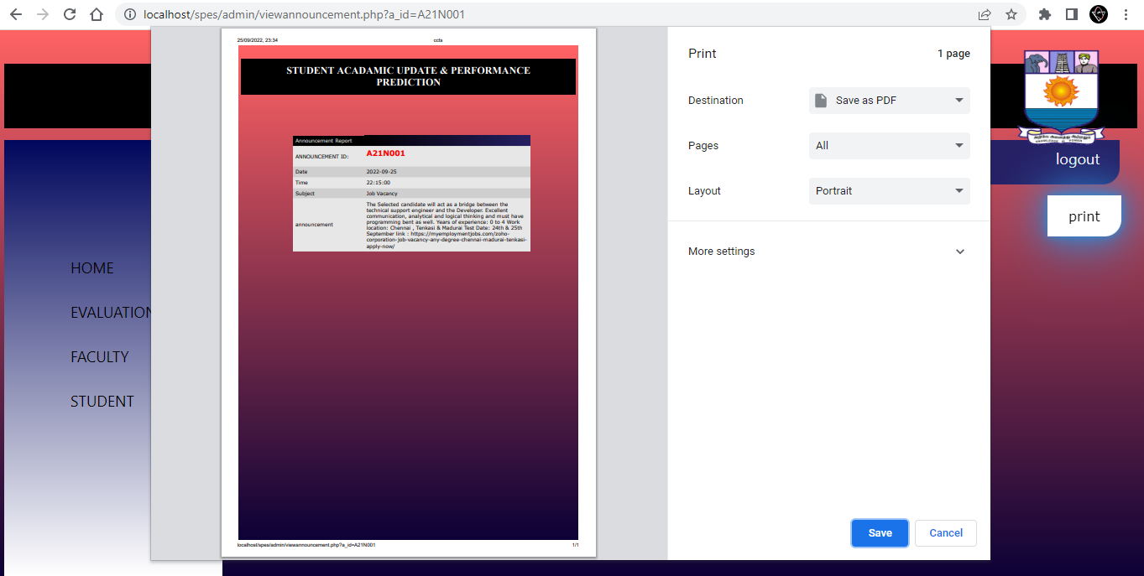
Print Announcement:

Slide 23

Thank you

